Slide 2
WebLogic on Kubernetes
Antonio Nappi​
Luis Rodriguez Fernandez​

Slide 3
Agenda
Introduction
Why Dockerize
Current Architecture
How it started
Session Stickiness and Security
Logging
Monitoring
Persistent Storage
Secrets
Single Sign on
Networking problems.
Oracle Kubernetes Test
Limitation
Kubernetes Federation
Demo
Conclusion and plans
Notes:
Hello today I'm gonna talk about a project that we are developing at CERN and it is one of the reasons why im here.

Slide 4
Introduction
Move WebLogic infrastructure to Docker containers
Run critical CERN applications on top of it.
Transparent for the users.
Use IT Department Services
OpenStack Magnum
Elastic Search
JVM Monitoring with Grafana
CephFS
Gitlab
SSO, etc...
Oracle Kubernetes Test
Notes:
Yesterday Luis talked about our group activies and in particular about the Middleware part. We are running in production WebLogic to host CERN critical applications about employee management, budget. We decide to investigatethe use of Docker Containers as solution to host our environmnet. At CERN we follow a rule : wetry to use as far we can IT department services to build ours. We use Magnum asplayer to create and manage Kubernetes Cluster, ES for logging, CephFS for storage,Gitlab as repository and image registry. In this context we started also to evaluate Oracle Cloud as a possible solution as disaster recovery.

Slide 5
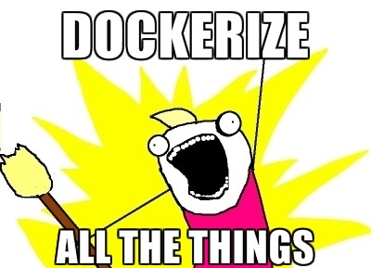
Why Dockerize I
Notes:
Why ? Why we should move everything to Docker containers?The reasons are various

Slide 6
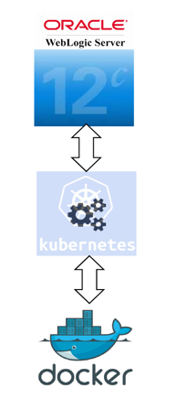
Why Dockerize II
Increase developer productivity :
Better testing.
Consistent development environments.
Make operations happy :
Repeatable
Faster and easier to deploy
Easier Disaster Recovery Plan
Simplify versioning control
Simple to maintain
Portable
Notes:
For sure one of more important isincrease thedeveloper productivity, the Holy Gral of informatics and make the life of operations much easier.

Slide 7
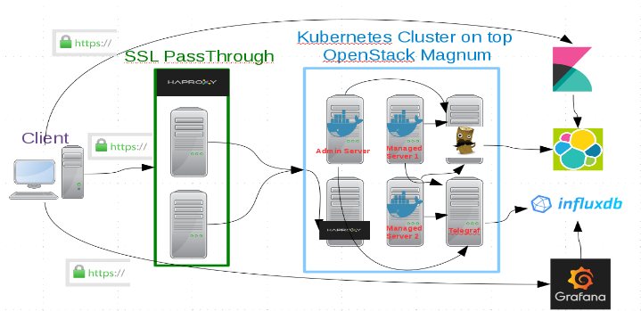
Current Architecture
Notes:
This is the current architecture that we have. There is a cluster with an Admin server and a number of Managed server that can go from 2 up to 8. Each member of wls cluster runs also filebeat to logstash container where the logs are parsed and sent to an ES instance that is running by IT department. and jolokia to retrieve JVM metrics and it is pulled by telegraf container that after ship the metrics to influxDB andthe data can be accessed using grafana. The only way to access is using theingress that use an haproxylb to redirect the traffic fromexternal network to thecluster. i will not go too much in details now because i will be more precise in the next s lides.
(respectively)

Slide 8
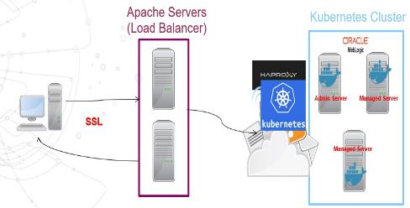
First architecture
CERN WLS images (rpms)
Latest patches
Apache as external load balancer
Optional internal HAProxy
NodePort could be enough
SSL termination
Notes:
This it the first architecture that we thought. We had just the externalLB to discriminate the different traffic among the clusters. In that scenario probably just the NodePort feature of Kubernetes was enought. The nodeport isa feature that allow to open on the minion of the kubernetes cluster a port that became reachable from external. We started from building our own images with wls binaries and all the patches that we needed. We have just one image where a start script, reading the environment variable that we pass, understand whici is its role (admin or managed), download a pack file,unpack and start the wls.

Slide 9
WebLogic images
weblogic-server
weblogic-base
cerndb-base-image
cc7-base
cc7 base image
CERN cc7 docker image
Cerndb-base-image
Cerndb tools
Weblogic base
WebLogic rpms
Weblogic server
A start script discriminate between AdminServer and Managed Servers

Slide 10
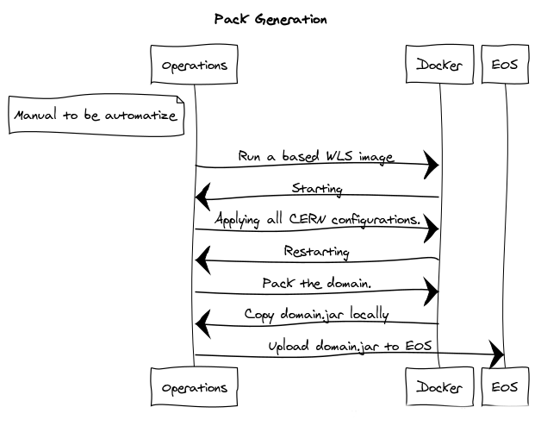
Notes:
We started from home-made images.

Slide 11
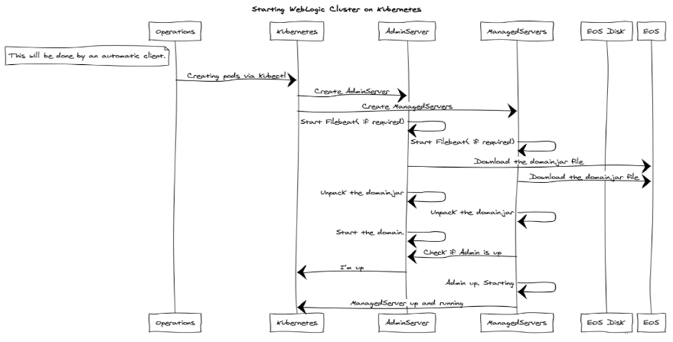

Slide 12
Session Stickiness and Security
Internal HAProxy is helpful to stick the sessions
Kubernetes NodePort's session affinity feature is not enough.
Automatically configured with Ingress
Use SSL to communicate with external LB
External Load Balancer
SSL passthrough
Helpful for maintenance
Discriminate among clusters
Notes:
External lb needed to be sure that there is something answering

Slide 13
Logging
Users need to access logs of application
Containers are ephemeral
Operations people needs to access raw logs
Data needs to be stored and easily accessible to debug
Distinguish logs of different Cluster
The architecture is the same for each application

Slide 14
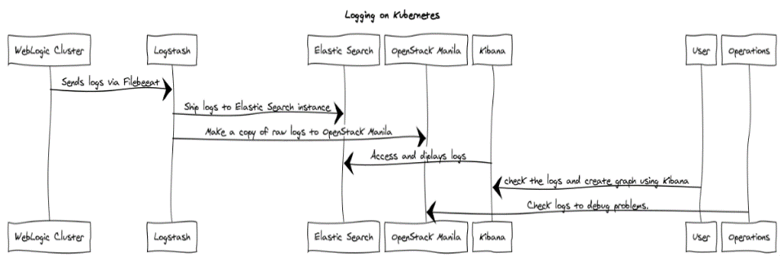

Slide 15
Logging
WebLogic log format is not well structured
Grok to parse into structured format

Slide 16
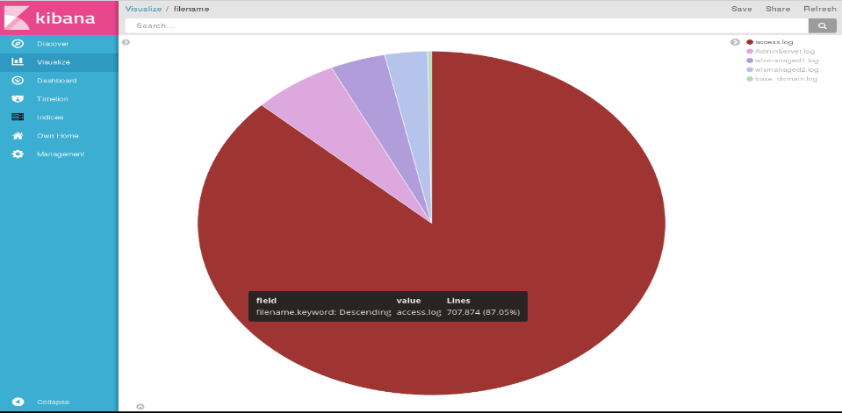
Notes:
Welogic format log is not apache format. We had to develop some grok and pattern to have a easy readble logs.

Slide 17
Live Monitoring
JMX via "classic" RMI connector
NODE_PORT open
-Djava.rmi.server.hostname=NODE_IP
JMX generic connector
JMX Messaging Protocol
JSE does not include it (jmxremote_optional.jar)

Slide 19
Persistent Storage
OpenStack Manila
Shared file system among clusters.
Coming "soon": home-made storage (EOS)
Helpful
Logging
Monitoring
Persistent application binaries and domain pack
Keep general image and allow customization

Slide 20
Secrets
Kubernetes secrets
As environment variables
Accessible from user application
Unset before start up.
As files.
Not encrypted.
Too many to generate
Ldap
Admin password
Keystore passwords
Certificate password.
….
Notes:
Too many for ldap, admin, certificate, keystore,

Slide 21
Single Sign on(saml2)
Tried to keep the same configuration running in the current production
Not work with WebLogic 12.2.1
PathTrim in the Apache WebLogic Plugin modifies the cookie path
Apache was not able to understand if WebLogic was up with the internal HAProxy in the middle
Moved to HAProxy
RDBM Store can we share one db for different cluster (?!)
No Needed anymore. Moving to container

Slide 22
Networking problems
All that cannot be tunneled does not work
T3 protocol
IDE WebLogic plugin does not work
HTTP makes the trick
JVM monitoring
Live Debugging

Slide 23
Kubernetes Federation
It works!
Nginx running.
DR solution candidate
Data replication.
Privacy.
Have a CLI client that helps you to configure would be great.
Thank to Ricardo Rocha and Clenimar Filemon.

Slide 24
Demo

Slide 25
Conclusion and plans
Dev & Test/Preprod for CERN developers
Production
First on premise
Later in Cloud
Make deployment more general.
Containerize everything (RDBMS stores, InfluxDB, etc.)
Remove CERN dependencies.(EOS etc. etc.)
Spinnaker evaluation
Wercker evaluation

Slide 26
Q & A

Slide 28
Reference
EOS (http://information-technology.web.cern.ch/services/eos-service)
https://fedoraproject.org/wiki/Koji
Contacts
antonio.nappi@cern.ch
luis.rodriguez.fernandez@cern.ch

